Slide 1

Notes:
Welcome to summoner’s rift!
Today, let me introduce you to a dialogue system that can help you become a League of Legends expert (maybe not).

Slide 2
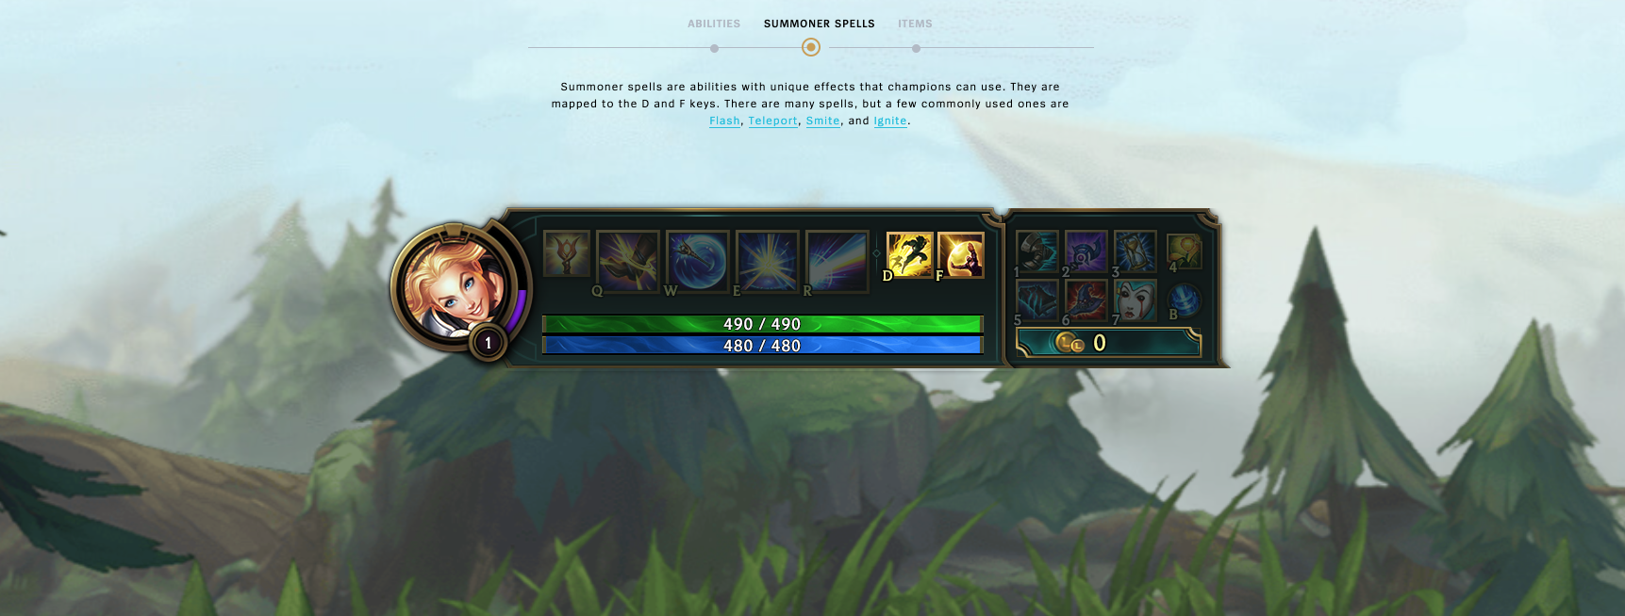
Notes:
无论你玩不玩这个游戏，首先我们要达成一个共识：Flash（a summoner spell）是很重要的，准确的掌握对手闪现的时间可以让你更容易取得胜利。Whether or not you know this game, we must first agree on one thing: Flash (a summoner spell) is very important, and accurately knowing the enemy's flash cooldown can make it easier for you to win.
闪现的冷却时间很长，长达5分钟，在一场混乱的游戏中，并不是游戏高手的我很容易忘记对手的闪现冷却好了没有。所以我的对话系统可以帮助我记录并且提醒我对手的闪现信息。
那么我们一起来看看它是怎么工作的吧！
The cooldown for flash is very long, up to 5 minutes, and in a chaotic game, as a junior player like myself, it's easy to forget whether the enemy's flash is on cooldown or not. That's why my dialogue system can help me record and remind me of the enemy's flash information. So let's take a look at how it works!

Slide 3
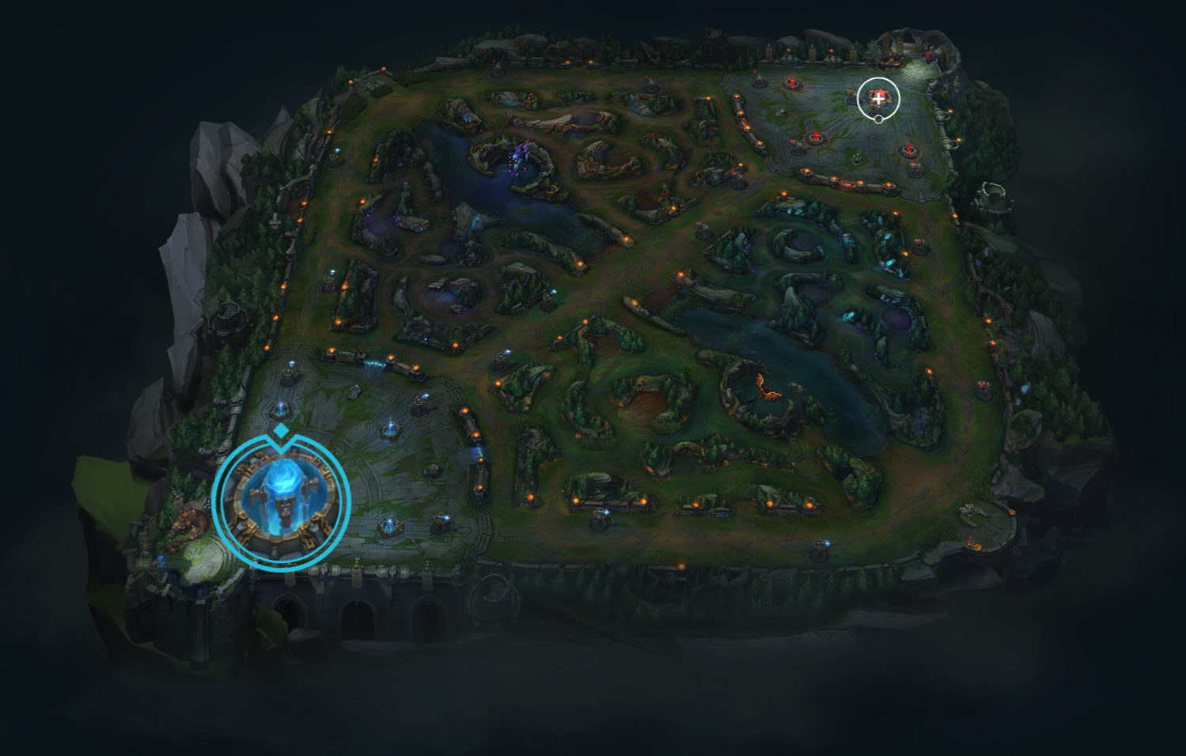
What does it do?
This is a voice assistant based on the game League of Legends,
designed to record and check the cooldown time of flash skills for different heroes.
Users can notify the assistant of a hero using the flash skill through voice input,
and the assistant will set different cooldown times based on the game mode (Summoner's Rift or Howling Abyss) and remind the user before the cooldown time ends.
Notes:
希望现在你已经明白了怎么使用这个系统。总的来说，首先我们要选择游戏模式，因为不同的模式对应不同的cd时间。进入游戏以后，系统会一直保持监听状态，当听到一个英雄闪现后，系统会为这个英雄开启倒计时，并会在倒计时结束前10秒和结束时发出提醒。在这5分钟里，我也说另一个英雄闪现，系统会再开启一个倒计时。不同英雄的倒计时是彼此独立的。我也可以询问系统某一个英雄的闪现好了没有。如果没有，系统还会告诉我剩余的冷却时间。Hopefully, by now you understand how to use this system. In general, we first need to select the game mode, because different modes correspond to different cooldown times. Once in the game, the system will remain in listening mode. When it hears a champion use Flash, the system will start a countdown for that champion, and will set a reminder 10 seconds before and at the end of the countdown. If I mention another champion's Flash during these 5 minutes, the system will start another countdown. The countdowns for different champions are independent of each other. I can also ask the system if a champion's Flash is ready or not. If it's not ready, the system will tell me the remaining cooldown time.

Slide 4
Technical details:
xstate library TypeScript.
The FuzzySet.js library was used for fuzzy matching of hero names.

Slide 5
Challenges:
The FuzzySet.js library was used for fuzzy matching of hero names.
To achieve fuzzy string matching,
the library calculates the similarity between strings.
Based on a pre-set threshold or the best match,
the library returns the hero name that is most similar to the input string.
Notes:
我遇到的第一个挑战是，lol有超过150个英雄，他们的名字有的发音很奇怪，有的很相似，如果系统识别不到或者识别错误反复的说：“sorry，。。。。“ 会影响游戏体验。所以我希望系统可以根据我的发音尽可能为我匹配一个存在的英雄的名字。另外一个方法是我可以根据我的发音喜好为英雄名字标注发音，但是英雄太多，我放弃了。
The first challenge I encountered was that there are over 150 champions in the game, and some of their names have strange pronunciations or are very similar to each other. If the system can't recognize or recognizes them incorrectly and repeatedly says "sorry...", it will affect the gaming experience. Therefore, I hope that the system can match a champion's name that exists as closely as possible based on my pronunciation. Another method would be for me to mark the pronunciation of champion names according to my own preferences, but there are too many champions and I gave up on this idea.

Slide 6
Challenges:
listening speaking
Notes:
遇到的困难是因为我希望系统一直在监听，所以当系统想要提醒我闪现马上好和已经好时，speaking 和listening冲突了。我想的解决办法是在提醒前暂停监听，在提醒结束后恢复监听，但是由于我还不知道的原因，没有成功。目前只能在console看到文字提醒消息。
Another difficulty is because I wanted the system to listen continuously, so when the system wanted to remind me that Flash was almost ready or already ready, there was a conflict between the "speaking" and "listening" modes. My solution was to pause the listening mode before the reminder and resume it after the reminder ended, but for some unknown reason, it didn't work. Currently, I can only see text reminder messages in the console.

Slide 7
Relation to the course:
TypeScript
statechart

Slide 8
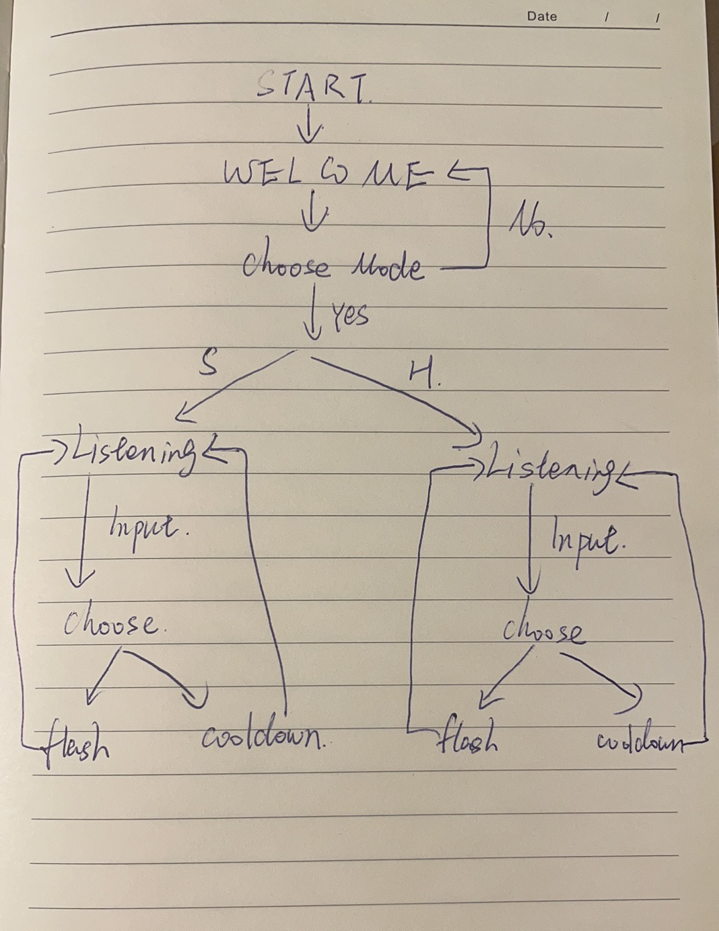
Relation to the course:
TypeScript
statechart
Notes:
这是我画的一个状态图草稿，因为我的流程整体不复杂，用状态图表示出来就更加容易理解，也方便找到遗漏的状态。
This is a draft of the state chart I drew. Since my overall process is not complex, representing it with a state chart makes it easier to understand and helps me identify any missing states.

Slide 9
Any ethical concerns？

Slide 10
NO！
Any ethical concerns？
Official：automatically recording hero skills is considered cheating.
ME：manually / verbally
Notes:
关于道德问题：可能有人会认为这一个作弊的脚本，会破坏游戏平衡，但是不是的。游戏官方规定自动记录英雄技能是作弊行为，但是我是手动（或者是嘴动）记录的，如果我自己没有观察到对手的闪现，就不会发生记录。
Regarding the ethical issue: Some people may think that this cheating script will disrupt the game balance, but that is not the case. The game officials prohibit automatic recording of champion skills as a form of cheating, but I am manually (or verbally) recording the skills. If I don't observe the opponent's Flash, no record will be made. Therefore, this script does not break any rules or cause any unfair advantage for me.

Slide 11

Future work
Listening & speaking
Alias and nicknames of champions
An item that can reduce the cooldown time.
Notes:
1. 解决speakling和listening冲突的部分the conflict between speaking and listening
2. 有一些英雄有别名和绰号，未来也可以添加。
Some champions have nicknames and aliases, and they can be added in the future.
3. 游戏中有一件装备可以缩短闪现的冷却时间。未来可以做的工作是：当我发现对方买了这件装备，我可以告诉系统，之后对于这个英雄的冷却时间计算也会改变。 In the game, there is an equipment that can shorten the cooldown time of Flash. In the future, I can add a feature where I can tell the system when I notice that the opponent has purchased this equipment, and the cooldown time for that particular champion will be adjusted accordingly.

